Slide 1
Medical Abstract Sentence Classifier using PubMed RCT
-By
Silviya X

Slide 2
Problem Statement
Medical research abstracts contain large amounts of textual information, making manual identification and organization of sentence roles time-consuming.
Using Natural Language Processing (NLP), this project automatically classifies each sentence of a medical abstract into five categories:
BACKGROUND
OBJECTIVE
METHODS
RESULTS
CONCLUSIONS
Objectives
Apply NLP techniques to medical research text.
Preprocess and represent medical sentences for classification.
Build and compare Logistic Regression, Text-CNN, and BiLSTM models.
Evaluate models using Accuracy and Macro F1-score.
Deploy the best-performing model using Streamlit.

Slide 3
Technology Stack
Programming: Python
Data Processing: Pandas, NumPy
NLP: Text preprocessing, TF-IDF, text vectorization
Machine Learning: Scikit-learn, Logistic Regression
Deep Learning: TensorFlow / Keras, Text-CNN, BiLSTM
Evaluation: Accuracy, Macro F1, Classification Report, Confusion Matrix
Deployment: Streamlit
Model Saving: Joblib
Development Environment: Google Colab
Dataset Description
Dataset: PubMed 20k RCT
Contains sentences from PubMed clinical research abstracts
Each sentence has a predefined section label.
5 target classes: BACKGROUND, OBJECTIVE, METHODS, RESULTS and CONCLUSIONS
Dataset is divided into Training, Validation, and Test sets.

Slide 4
Project Workflow
PubMed RCT Dataset Collection
↓
Data Loading & Exploration
↓
Data Preprocessing
↓
TF-IDF Feature Extraction
↓
Model Training (Logistic Regression + Text-CNN + BiLSTM)
↓
Model Evaluation (Accuracy + Macro F1 + Classification Report)
↓
Model Comparison & Best Model Selection
↓
Model Saving using Joblib
↓
Streamlit Application Development
↓
Medical Abstract Sentence Classification
↓
Color-Coded Prediction Output

Slide 5
Data Preprocessing & Data Quality Checks
Data Loading & Structuring
Loaded the raw PubMed RCT dataset
Parsed the text data into a structured Pandas DataFrame
Extracted abstract_id, sentence, and label
Data Quality Checks
Checked dataset shape and structure
Checked for missing/null values
Checked for duplicate records
Examined the label/class distribution
Verified the five target classes: BACKGROUND, OBJECTIVE, METHODS, RESULTS and CONCLUSIONS
Data Preparation
Separated sentence text as input variable
Separated section label as target variable
Encoded the categorical labels for model training
Maintained separate training, validation, and test datasets

Slide 6
Feature Preparation: TF-IDF
1. Text Feature Extraction
Used TF-IDF (Term Frequency–Inverse Document Frequency) to convert text into numerical features
Transformed medical sentences into a sparse numerical feature matrix
Fitted the TF-IDF vectorizer on the training data
2. Feature Transformation
Applied the same fitted vectorizer to validation and test datasets
Ensured consistent feature representation across all datasets
3. Input for Baseline Model
TF-IDF features were used as input to the Logistic Regression classifier
This provided a classical NLP baseline for comparison with neural models
Flow:
Medical Sentences → TF-IDF Vectorization → Numerical Feature Matrix → Logistic Regression

Slide 7
Baseline Model: Logistic Regression
1. Model Selection
Used Logistic Regression as the classical NLP baseline
Suitable for multi-class sentence classification
2. Model Training
Input: TF-IDF feature matrix
Target: Encoded sentence labels
Trained the model using the training dataset
3. Model Validation
Evaluated performance on the validation dataset
Used Accuracy and Macro F1-score
Generated a classification report to analyze individual classes
4. Purpose
Established a baseline performance
Provided a reference point for comparison with Text-CNN and BiLSTM

Slide 8
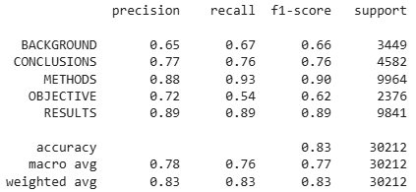
Logistic Regression: Model Evaluation
Performance Evaluation
Evaluated the trained Logistic Regression model on the validation dataset
Calculated Accuracy and Macro F1-score
Accuracy: 83.12%
Macro F1-score: 76.71%
Generated a Classification Report

Slide 9
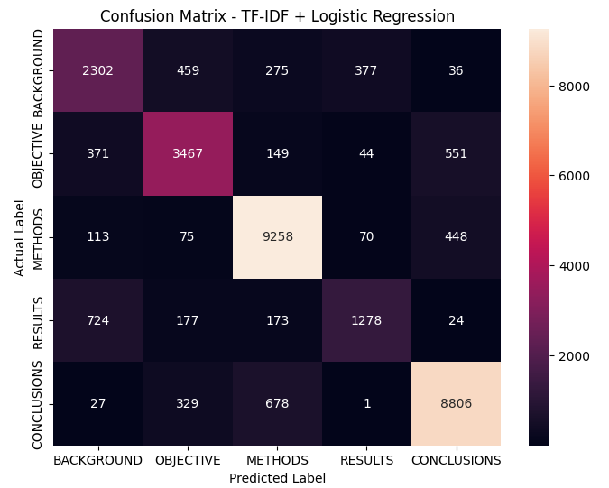
Confusion Matrix Analysis
Generated a confusion matrix to understand prediction errors
Compared actual labels vs predicted labels
Identified which sentence categories were frequently confused
Helped understand class-level model performance

Slide 10
Neural NLP Preparation
1. Text Vectorization
Converted medical sentences into numerical sequences using TextVectorization
Vocabulary size: 50,000
Sequence length: 50 tokens
2. Dataset Preparation
Converted training, validation, and test sentences into fixed-length sequences
Prepared numerical sequences as input for neural network models
3. Neural Models
Text-CNN — captures important local patterns and phrases
BiLSTM — captures contextual information from both directions

Slide 11
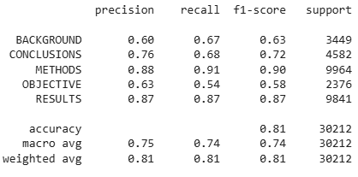
Text-CNN Model
1. Model Architecture
Used a Text-CNN for sequence-based text classification
Input: Fixed-length token sequences
Used an Embedding layer (128 dimensions ) to learn word representations
Applied 1D Convolution (128 filters with kernel size 5) to capture important local patterns in sentences
Used Dense layers (64 units) for classification
Added Dropout to reduce overfitting
Output layer predicts one of the 5 sentence categories
2. Training
Trained the Text-CNN model for 5 epochs
Used the prepared token sequences as input
Evaluated performance on the validation dataset
3. Validation Performance
Accuracy: 80.72%
Macro F1-score: 74.00%
Input Sentence → TextVectorization → Embedding (128) → Conv1D (128 filters, kernel 5) → Dense (64) → Dropout → Output (5 Classes)

Slide 12
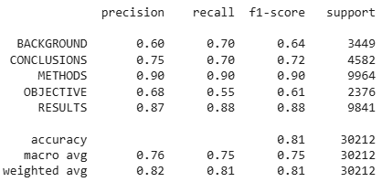
BiLSTM Model
1. Model Architecture
Used a Bidirectional LSTM (BiLSTM) for sequence-based text classification
Input: Fixed-length token sequences
Used an Embedding layer (128 dimensions)to learn word representations
Applied Bidirectional LSTM (64 units)to capture contextual information from both directions
Used a Dense layer (64 units) for classification
Added Dropout to reduce overfitting
Output layer predicts one of the 5 sentence categories
2. Training
Trained the BiLSTM model for 5 epochs
Used the prepared token sequences as input
Evaluated performance on the validation dataset
3. Validation Performance
Accuracy: 81.40%
Macro F1-score: 75.07%
Input Sentence → TextVectorization → Embedding (128) → BiLSTM (64) → Dense (64) → Dropout → Output (5 Classes)

Slide 13
Model Comparison & Final Model Selection
Model Comparison
Model | Validation Accuracy | Validation Macro F1
Text-CNN | 80.72% | 74.00%
BiLSTM | 81.40% | 75.07%
TF-IDF + Logistic Regression | 83.12% | 76.71%
Final Model Selection
Compared all three models using Accuracy and Macro F1-score
TF-IDF + Logistic Regression achieved the best validation performance
Selected it as the final model
Used the selected model for final test evaluation and Streamlit deployment
Final Model:
TF-IDF + Logistic Regression

Slide 14
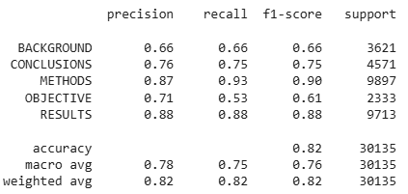
Final Test Evaluation
1. Final Model Evaluation
Evaluated the selected TF-IDF + Logistic Regression model on the unseen test dataset
Generated predictions for the test sentences
Calculated Accuracy and Macro F1-score
Generated the classification report
2. Final Test Performance
Accuracy: 82.29%
Macro F1-score: 75.98%
3. Classification Report

Slide 15
Prediction Functions & Demo
1. Prediction Function
Created a prediction function for classifying individual medical sentences
Applied the saved TF-IDF vectorizer to the input sentence
Passed the transformed features to the Logistic Regression model
Returned the predicted sentence category
2. Abstract Classification
Accepted a complete medical abstract as input
Split the abstract into individual sentences
Classified each sentence separately
Displayed the predicted category for every sentence
3. Example Prediction
Input:“The study was conducted to evaluate the effectiveness of the treatment.”
Predicted Class: OBJECTIVE

Slide 16
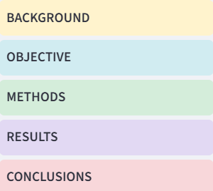
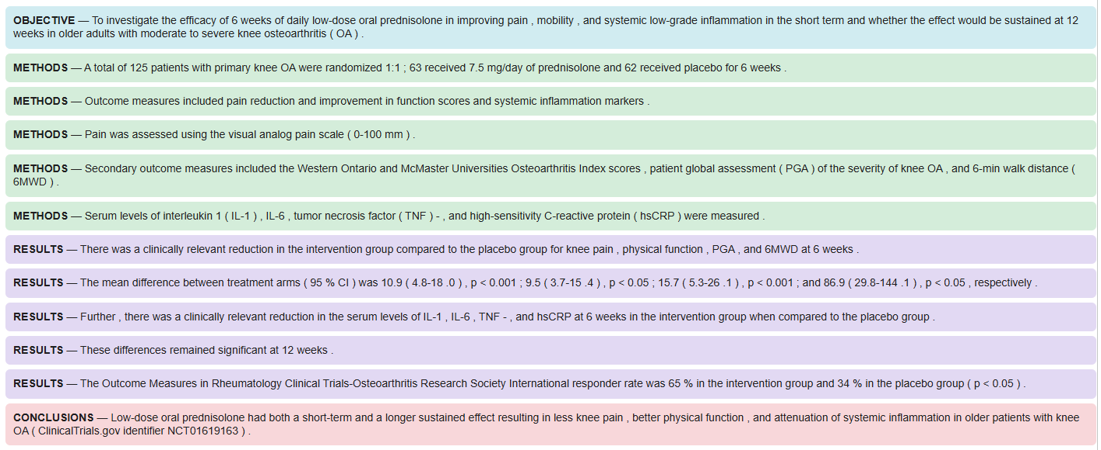
Color-Coded Abstract Output
1. Result Presentation
Displayed the classification result for each sentence
Each sentence is shown together with its predicted category
Used different background colors for the five sentence classes
This makes the abstract structure easier to understand visually
2. Output

Slide 17
Model Persistence & Streamlit Application
1. Model Persistence
Saved the trained Logistic Regression model
Saved the TF-IDF vectorizer
Used joblib for saving and loading the model components
Enables the trained model to be reused without retraining
2. Streamlit Application
Developed a Streamlit web application
User can enter a complete medical abstract
The application splits the abstract into sentences
Each sentence is classified using the saved TF-IDF + Logistic Regression pipeline
3. Output
Displays the predicted label for each sentence
Uses color-coded output for easy interpretation
Supports the five sentence categories: BACKGROUND, OBJECTIVE, METHODS, RESULTS, CONCLUSIONS

Slide 18
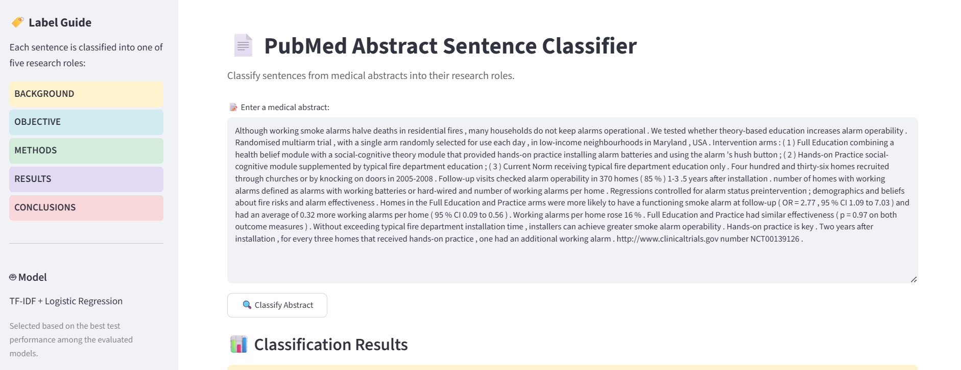
Streamlit Output

Slide 19
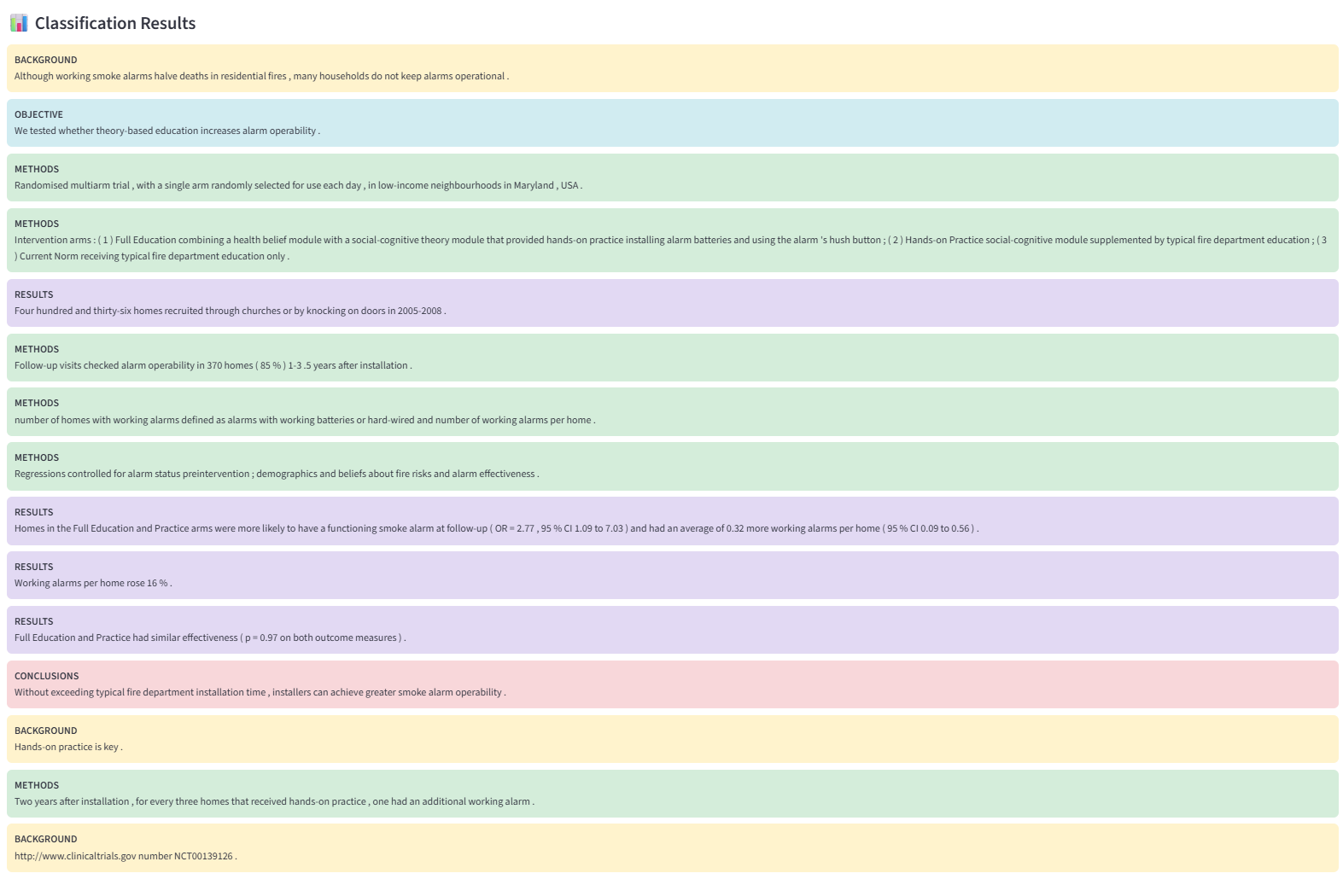

Slide 20
Conclusion
End-to-End Workflow
Dataset → Data Preprocessing → Data Quality Checks → TF-IDF → Logistic Regression → Neural Model Comparison → Final Model Selection → Test Evaluation → Streamlit Deployment
Key Results
Compared Text-CNN, BiLSTM, and TF-IDF + Logistic Regression
TF-IDF + Logistic Regression achieved the best validation performance
Validation Accuracy: 83.12%
Validation Macro F1-score: 76.71%
Final Test Accuracy: 82.29%
Final Test Macro F1-score: 75.98%
Successfully deployed the selected model using Streamlit
Final takeaway
The project demonstrates an end-to-end Biomedical NLP pipeline for automatically identifying the structural role of sentences in medical research abstracts.
Thank You!

